Slide 1
TOWN DEAL BOARD PROGRAMME REPORT
BUSINESS CASE STAGE

Slide 2
GUIDE TO COMPLETING THIS REPORT
This report is editable. You may wish to add further detail or tailor the content based on local needs.
PROJECT UPDATES
Project leads should be asked to provide the details required for this slide. You may already have established a mechanism for them to report monthly on the project. If so, the pertinent information can be moved across from those reports.
RAG (Red/Amber/Green) ratings are provided to help quickly identify what is on track and what is at risk.
We recommend that you cast a critical eye over the information provided. You will need to ensure that the pitch of the information is at the right level for the Board; they won’t need every last detail. Also be mindful of whether there is a sense of progress, i.e. have the actions described in the previous report been taken, or is there a clear rationale why not? Is there evidence that the risks are being managed? Does what you know about the current status of the project fit with what the report states?
You may need to revert back to the project lead to check details before circulation to Board members.
RAG (Red/Amber/Green rating system)
Ratings are provided to help quickly identify what is on track and what is at risk. Considerations for these could include time, quality, cost and stakeholder engagement.
At significant risk of failure to deliver, requiring immediate attention and corrective action to be taken
Serious risk(s) which could have a major impact on the project and which need to be managed closely
Potential risk(s) exist which could have an impact on the project and need to be managed
Low level or emerging risk(s) which could impact the project but which can be managed
Minor risk(s) unlikely to have impact on the project

Slide 3
GUIDE TO COMPLETING THIS REPORT
This report is editable. You may wish to add further detail or tailor the content based on local needs.
PROGRAMME OVERVIEW
This slide should be updated by the PMO or programme manager, based on their view of the projects as a collective.
The programme plan at the top allows Board members to see what is due to happen when. By providing a RAG rating for the current month and last month, you will give a sense of how on track a project or activity is and whether the situation is slipping or improving.
Programme risks are the risks that the programme team and Board will be most focused on mitigating. Some risks may come from one individual project, although it is more likely that they will represent the risks across all or a number of projects, e.g. cost escalation.
There is space to update the Board on any key achievements or upcoming milestones. There is also space to update the Board on actual spend vs budget. Lastly, you may wish to give the programme an overall RAG rating based on the information presented throughout the pack.

Slide 4
PROJECT UPDATES (example)
BUSINESS CASE | COMPLETION DATE (including full independent assurance and approval) | PROGRESS UPDATE | KEY RISKS | OUTCOMES MANAGEMENT
PROJECT 1 Skills hub | 31/01/21 | Project lead provides headline information on progress towards business case and project initiation | Project lead ensures Board sighted on any key risks or new risks | RAG rating of whether project can deliver planned outcomes
PROJECT 2 Innovation centre | 31/03/21
PROJECT 3 Museum | 31/03/21
PROJECT 4 Public realm | 31/01/21
PROJECT 5 Active travel | 31/01/21
PROJECT 6 Community hub | Fast-track 30/10/21

Slide 5
PROGRAMME OVERVIEW (example)
KEY |  | Independent assurance/approval
 |  | Business case complete
 |  | Summary documents submitted
Project | RAG |  | July-Sept |  |  | Oct-Dec |  |  | Jan-March |  |  | April-June
Project 1: Skills hub | Last month | This month |  |  |  |  | Draft complete
Project 2: Innovation centre |  |  |  |  |  |  |  |  | Draft complete
Project 3: Museum |  |  |  |  |  |  |  |  | Draft complete
Project 4: Public realm |  |  |  |  |  |  | Draft complete
Project 5: Active travel |  |  |  |  |  |  | Draft complete
Project 6: Community hub |  |  |  | Draft complete
Summary documents to MHCLG
Engagement Plan
Monitoring outcomes
Top programme risks | RAG | Mitigations
Provide overview of each risk and potential impact |  | Describe the key actions being taken to manage/minimise the risk here | Risk owner
Provide overview of each risk and potential impact |  | Describe the key actions being taken to manage/minimise the risk here | Risk owner
Provide overview of each risk and potential impact |  | Describe the key actions being taken to manage/minimise the risk here | Risk owner
Provide overview of each risk and potential impact |  | Describe the key actions being taken to manage/minimise the risk here | Risk owner
Milestones
Achieved since last Board | Upcoming milestones
Note any key milestones since last Board, e.g. on engagement or completion of a business case
Budget
Actual spend | Budget | Forecast outturn
£ | £ | £
Overall programme rating

Slide 6
PROGRAMME OVERVIEW Template
KEY |  | Independent assurance/approval
 |  | Business case complete
 |  | Summary documents submitted
Project | RAG |  | July-Sept |  |  | Oct-Dec |  |  | Jan-March |  |  | April-June
Top programme risks | RAG | Mitigations
Milestones
Achieved since last Board | Upcoming milestones
Budget
Actual spend | Budget | Forecast outturn
£ | £ | £
Overall programme rating

Slide 7
DECISIONS FOR THE BOARD
The Board is asked to make a decision on the following:
Insert details here of any decisions to be made

Slide 9
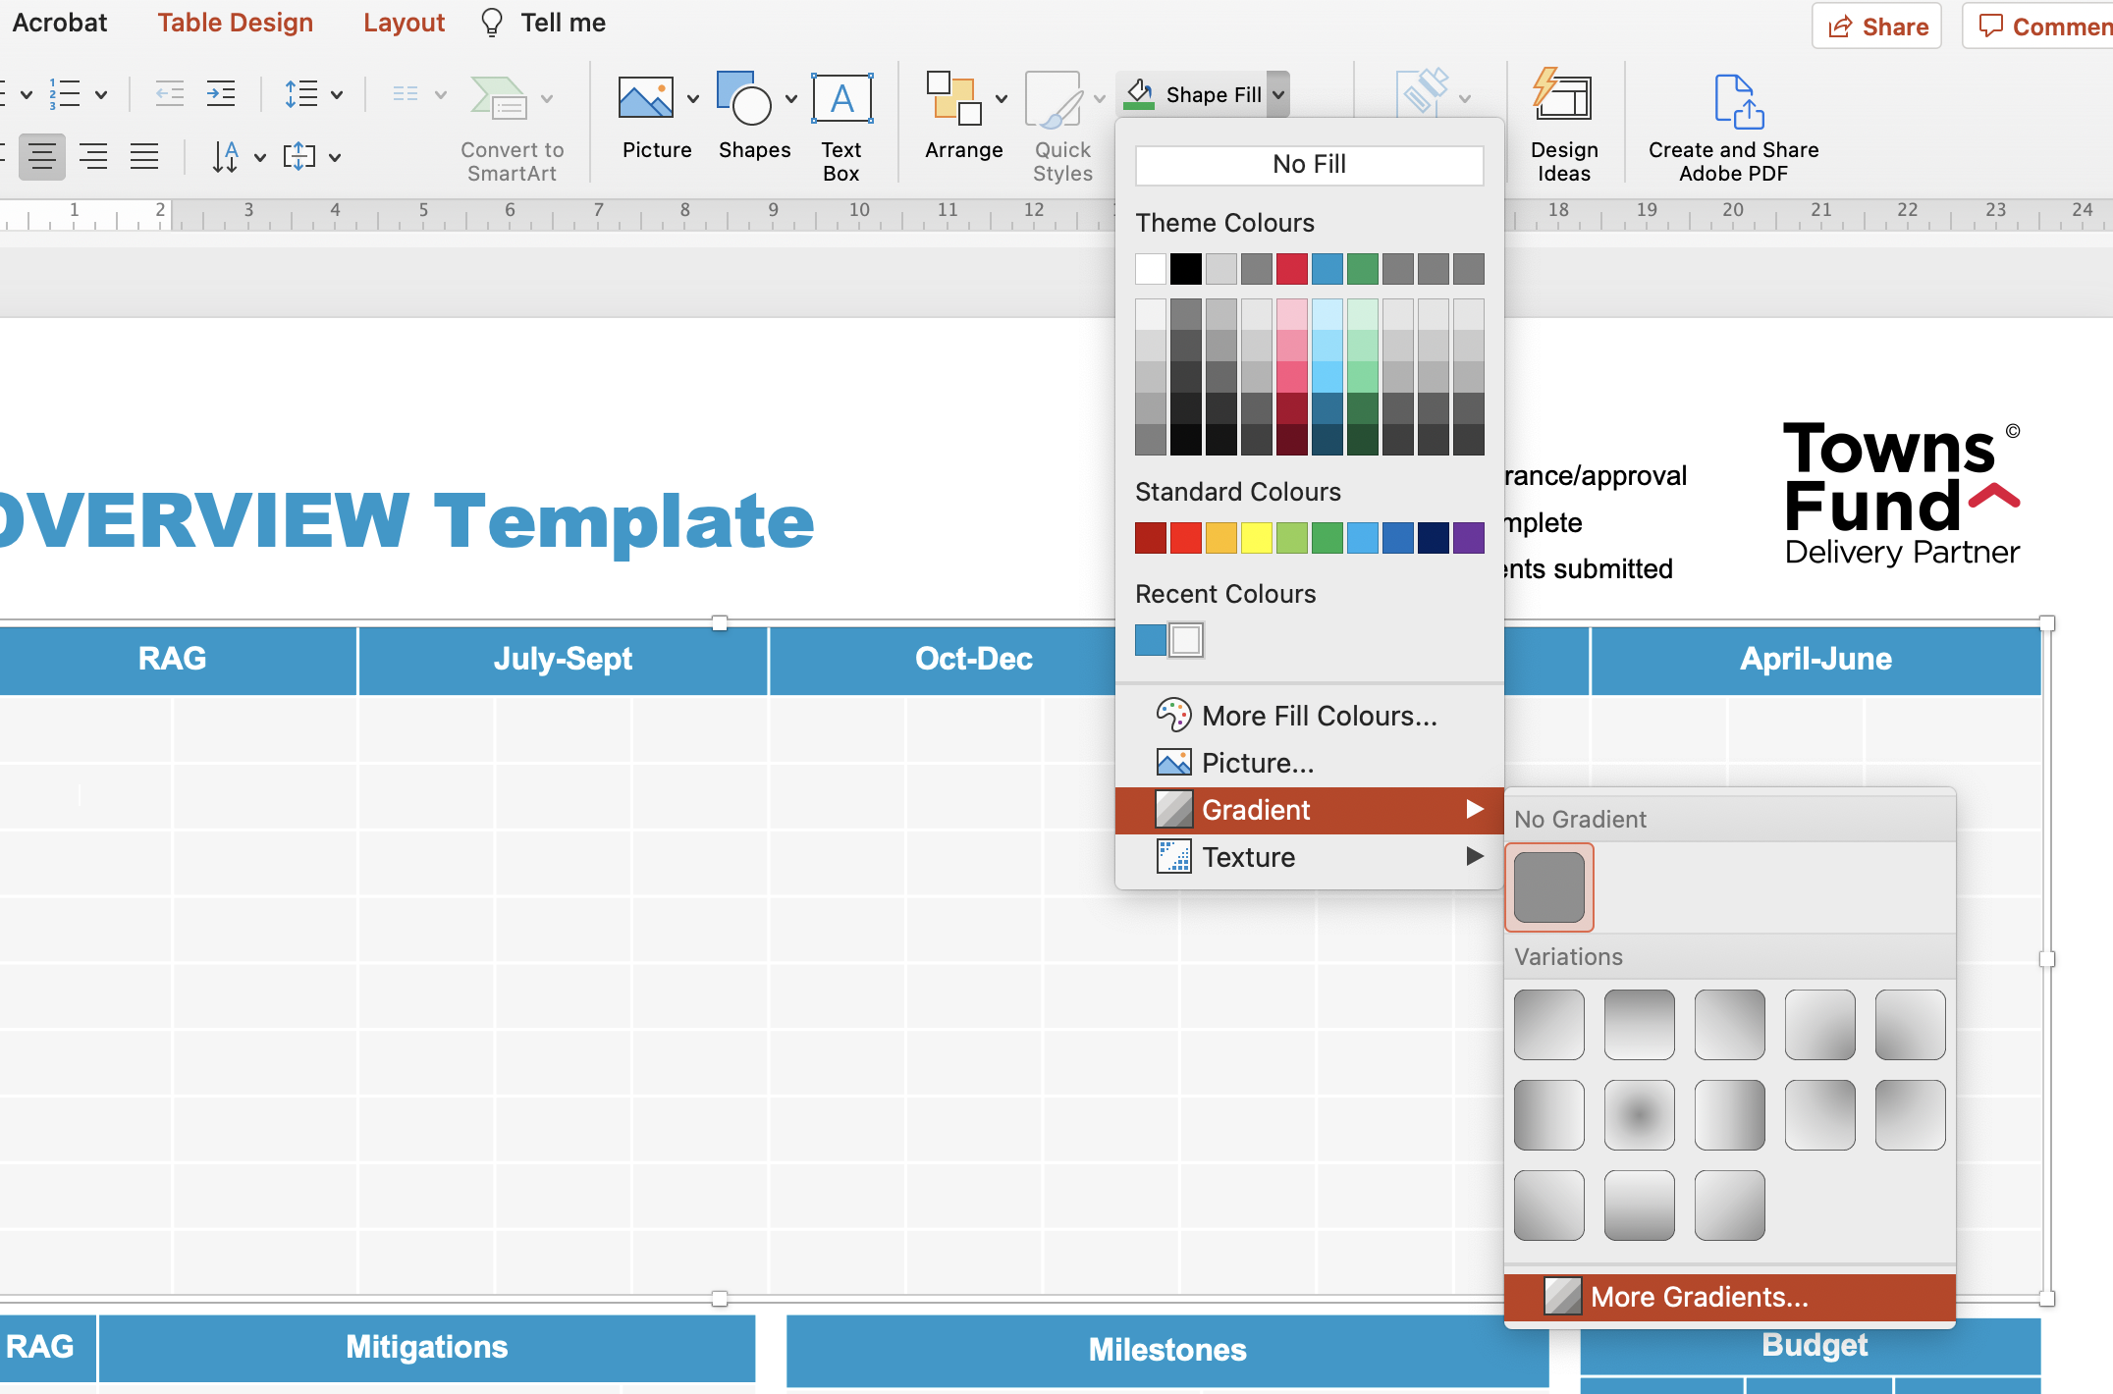
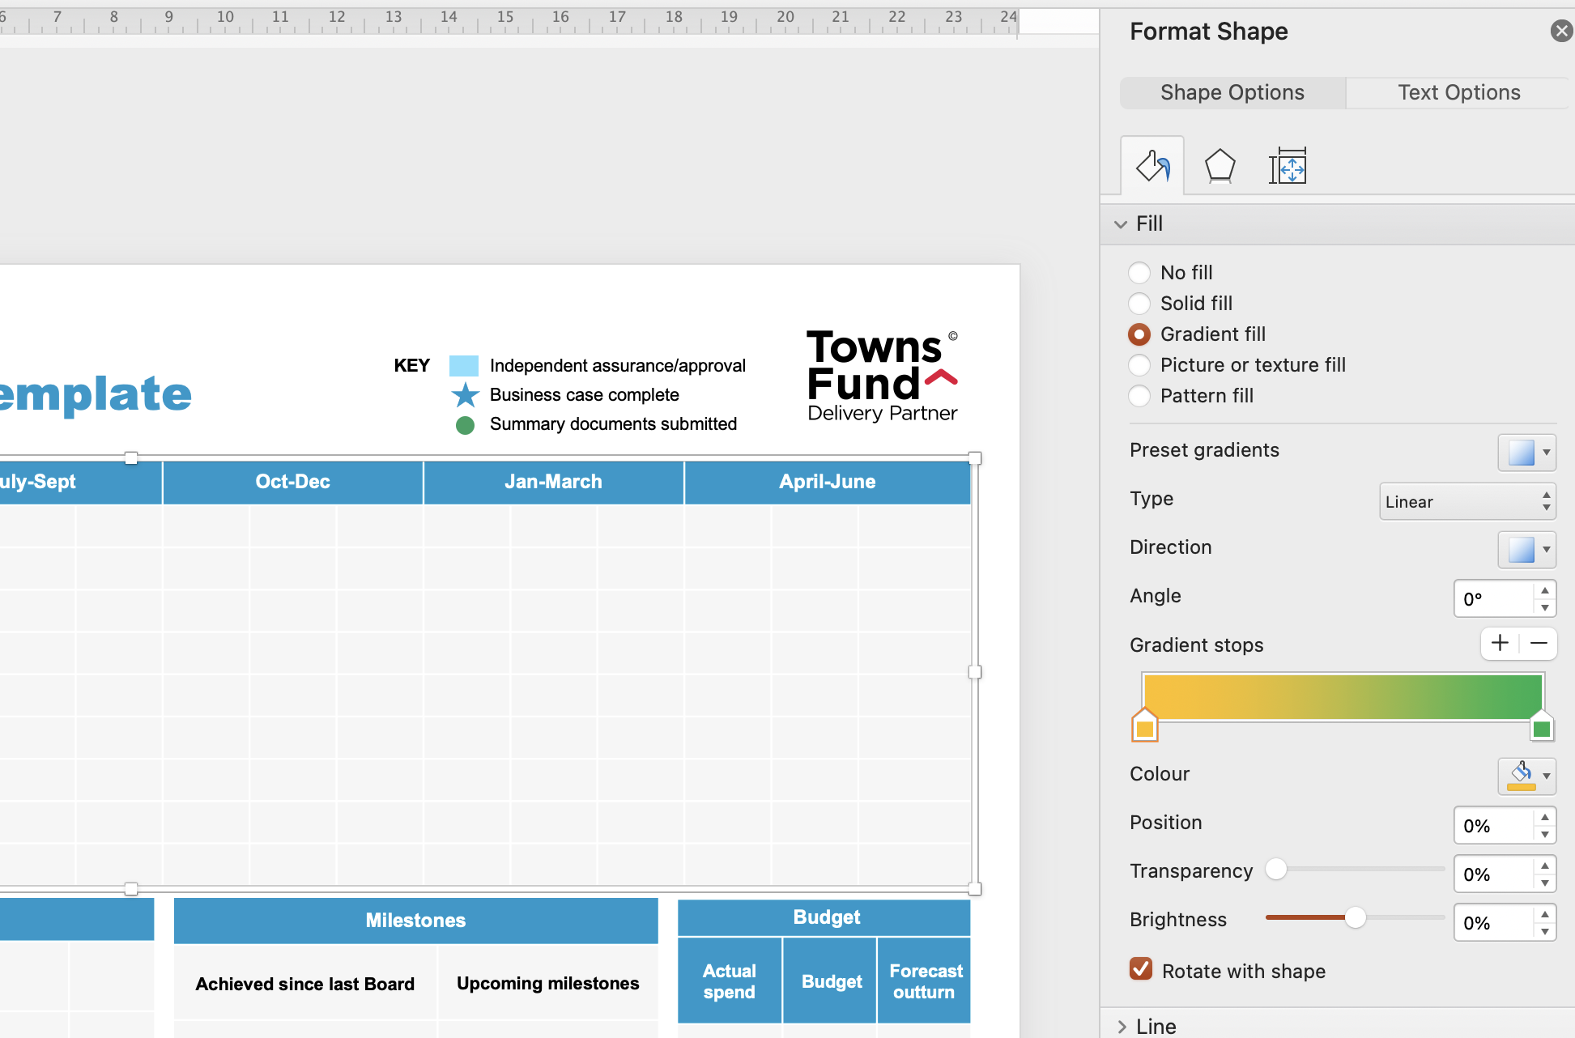
HOW TO ADD GRADIENTS TO YOUR RAG CELLS
How to add gradient cells (2 options)
Option 1 (existing cell)
Right-click the cell you want to add gradient
Select ‘Format Shape’
Under ‘Fill Options’ select ‘Gradient Fill’.
Select the colours of your gradient using the paint bucket icon. (For ease of use, in the Gradient Type option select Linear and in the Angle field type 0°)
Option 2 (new row to add – illustrated to right)
Insert new RAG row as required Click on a cell of the table and go to the Layout tab in the top ribbon. Then select Insert Above/Below if you need to add a new row.
Click on the required cell and, in the main tool bar select, ‘Shape Fill’
Select ‘Gradient’ and then click on ‘More Gradients’.
A tab will appear on the right hand side. Select ‘Gradient fill’ and select the colours of your gradient using the paint bucket icon. (For ease of use, in the Gradient Type option select Linear and in the Angle field type 0°)
1.
2.
3.
4.

